Slide 1

The Royal College of Emergency Medicine
Clinical Audits
VTE Risk in Lower Limb Immobilisation in Plaster Cast
Clinical Audit 2015-16
National findings

Slide 2

Contents
This shows how EDs are performing against the audit standards.
For further information, please see the national report.

Slide 3
Audit objective
Identify current performance in EDs against clinical standards and display the results in order to facilitate quality improvement.

Slide 4


Standards
Standard | Standard type
1. If a need for thromboprophylaxis is indicated, there should be written evidence of the patient receiving or being referred for treatment. | Fundamental
2. Evidence that a patient information leaflet outlining the risk and need to seek medical attention if they develop symptoms for VTE has been given to all patients with temporary lower limb immobilisation. | Developmental

Slide 5
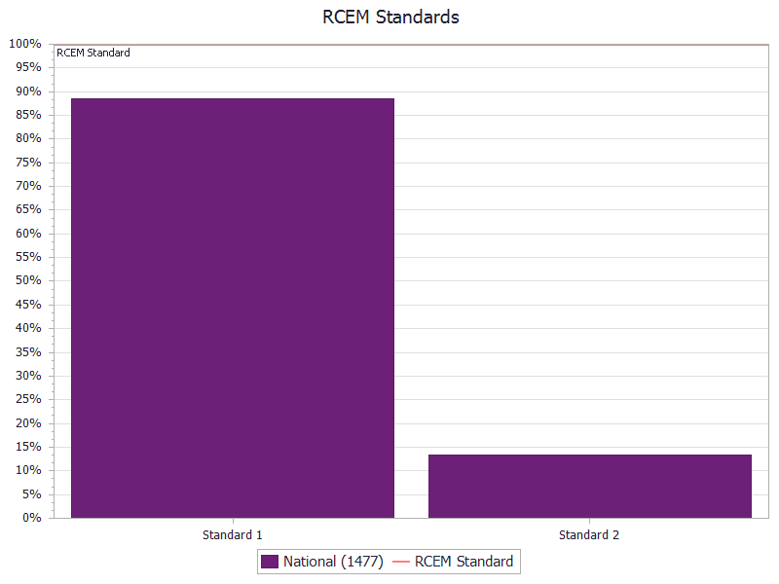


Executive summary
Standard 1
Standards:
Fundamental
Developmental
This graph shows how EDs performed on all standards for this audit.
↑ Higher scores (e.g. 100%) indicate higher compliance with the standards and better performance.
Standard 2

Slide 6


National results
 | RCEM Standard | National Results (9916 cases)
 |  | Lower quartile | Median* | Upper quartile
Assessment
VTE risk assessment carried out |  | 0% | 11% | 40%
VTE risk level documented |  | 50% | 84% | 98%
Thromboprophylaxis indicated |  | 0% | 6% | 22%
Treatment
STANDARD 1: If a need for thromboprophylaxis is indicated, there should be written evidence of the patient receiving or being referred for treatment. | 100% | 89% | 100% | 100%
Patient information
STANDARD 2: Evidence that a patient information leaflet outlining the risk and need to seek medical attention if they develop symptoms for VTE has been given to all patients with temporary lower limb immobilisation. | 100% | 0% | 2% | 17%

Slide 7
Casemix
How do patients attending EDs compare nationally?
This section helps you understand more about the case mix and demographics of the patients.

Slide 8
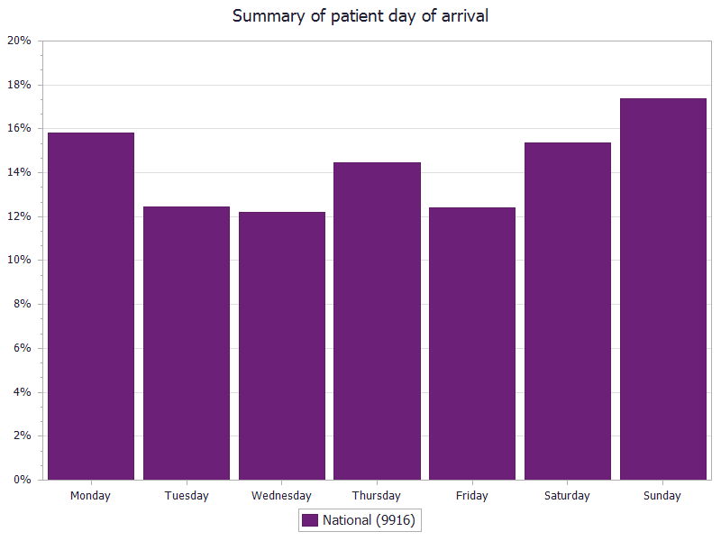
Date of arrival

Slide 9
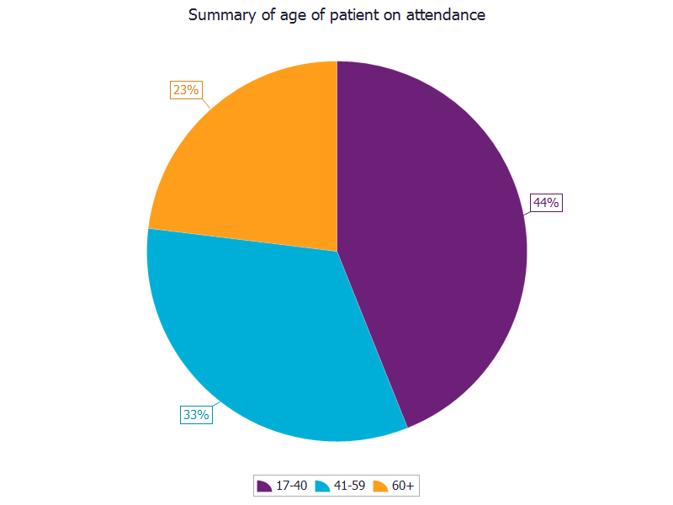
Patient age
Sample: all patients
This is unlikely to be representative of all fractures presenting to ED. Older patients are more likely to have displaced/unstable fractures that may need internal fixation or be unsuitable for discharge and therefore to be admitted to hospital.

Slide 10
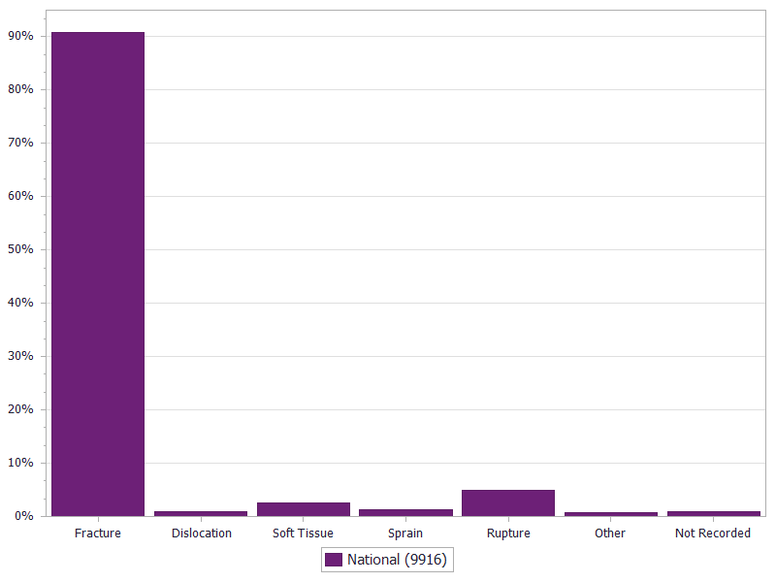
Diagnosis
Sample: all patients
This confirms that the overwhelming indication for plaster cast (or backslab) immobilisation of a lower limb is fracture.
It should be noted that fractures may occur in combination with other injuries which may affect the clinical decision to immobilise.

Slide 11
Audit results
How did EDs perform against the standards?
This section helps you understand more about how EDs performed nationally.

Slide 12
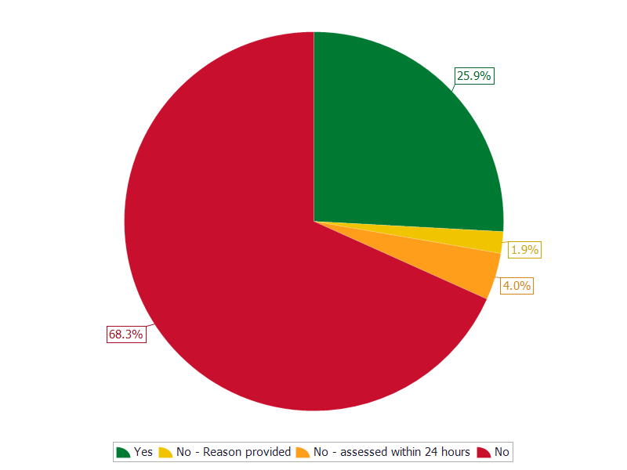
VTE risk assessment in the ED
Sample: all patients
This shows that only a quarter of patients have a formal VTE assessment recorded in the ED.
A further 4 % were assessed at a review within 24 hours of ED attendance.

Slide 13
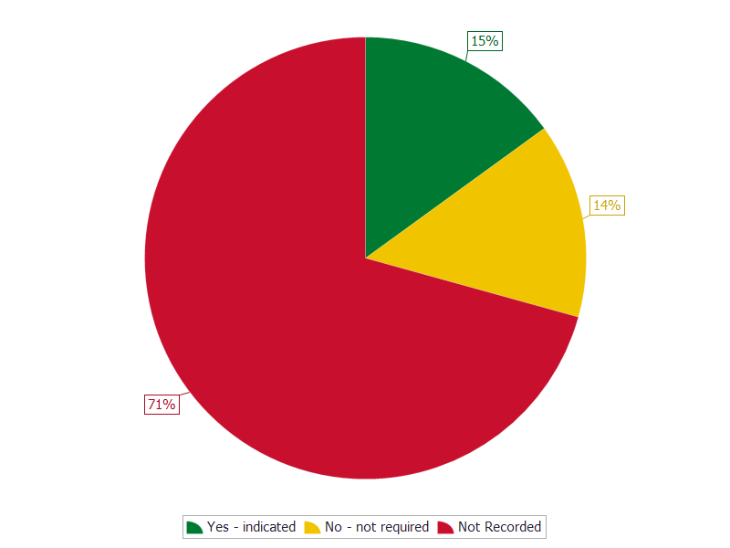
Was thromboprophylaxis indicated?
Sample: all patients
Thromboprophylaxis indication was not documented in 71% of cases. This is an area RCEM encourages improvements to be made. Where documented, thromboprophylaxis was definitively indicated for half of these patients.

Slide 14
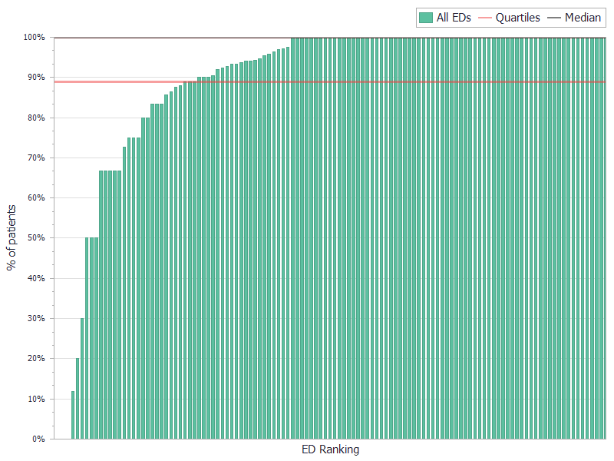
Written evidence of the patient receiving or being referred for thromboprophylaxis
STANDARD 1: If a need for thromboprophylaxis is indicated, there should be written evidence of the patient receiving or being referred for treatment.
Sample: Q6=yes (n=1477)

Slide 15
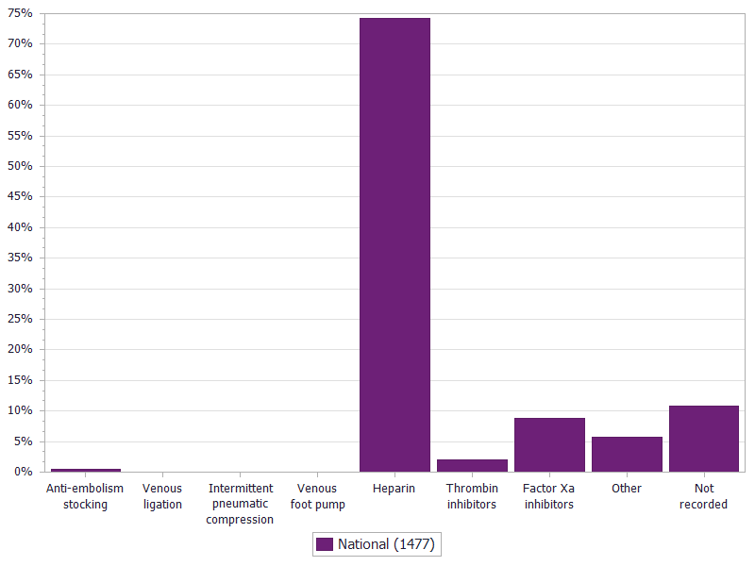
Thromboprophylaxis type
Sample: Q6=Yes – indicated (n=1477)
Heparin is by far the most commonly used treatment.
In 10% of patients, the type of thromboprophylaxis is not recorded. This may not necessarily indicate poor practice as there may be an alternative arrangement in place, e.g. patient is seen in a fracture clinic the following day, where VTE prophylaxis is conducted.

Slide 16
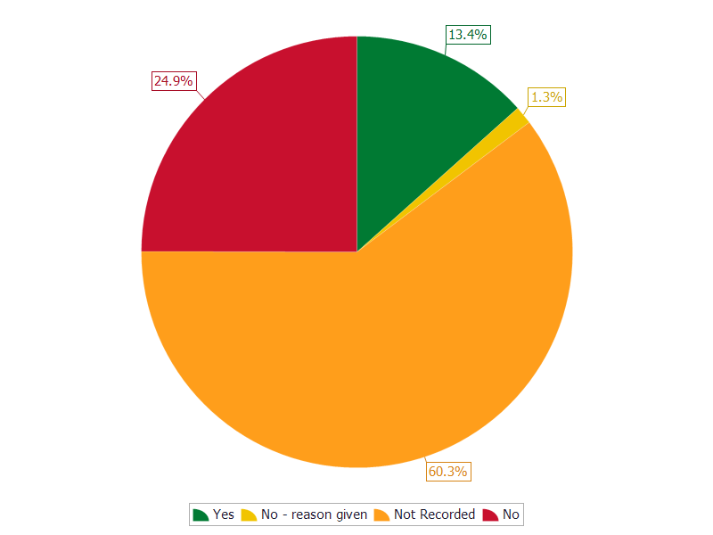
Information leaflet on VTE risk provided to the patient
STANDARD 2: Evidence that a patient information leaflet outlining the risk and need to seek medical attention if they develop symptoms for VTE has been given to all patients with temporary lower limb immobilisation.
Sample: all patients
There is a clear benefit to providing written information to patients as we know that verbal communication in the ED may not be retained for a variety of reasons.

Slide 17
Recommendations
ED clinicians should ensure that VTE risk assessment is conducted and clearly documented.
EDs should ensure that where risk assessment and prophylaxis is provided outside of the ED there is a safe system that documents this. EDs may wish to consider developing or modifying a plaster cast prescription form to include VTE prophylaxis .
Where thromboprophylaxis is indicated, ED clinicians should keep written evidence of patients receiving or being referred for treatment.
RCEM will develop a template patient information leaflet for ED clinicians to use or modify.
ED clinicians should document evidence of providing all patients with lower limb immobilisation information leaflets, outlining the risk and the need to seek medical attention if they develop symptoms of VTE.

Slide 18

Next steps
Read the full report
Action planning
Rapid cycle quality improvement
Contact other EDs for tips & solutions

