Slide 1
NAP8: Regional Anaesthesia
in Emergency Medicine
RCEM National Audit Programme
UK & Ireland

Slide 2


Why This Matters
  Regional anaesthesia is increasingly used in EM
  Practice and training vary between departments
  Limited national data currently available
Opportunity to improve patient care and safety

Slide 3

What is NAP8?
A national audit exploring
  Practice of regional anaesthesia in EM
  Complications and safety
  Training and delivery across sites

Slide 4



How NAP8 works
NAP8 has three parts:
  Baseline Survey - current practice and experience - OPEN
  Activity Survey - snapshot of ED activity - opens 1-7 June
  Case Registry - reporting complications - opens June
Together, these will build a national picture of regional anaesthesia in EM

Slide 5
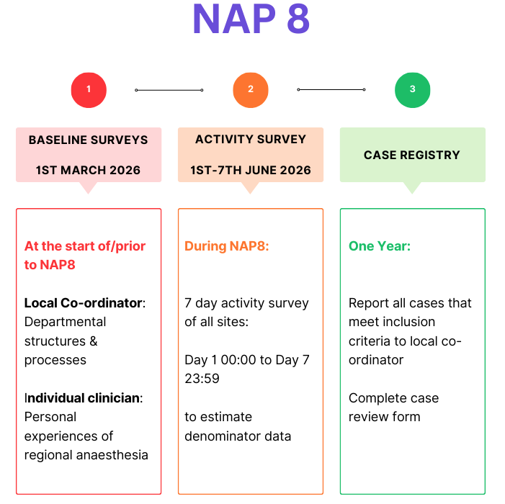
How NAP8 works

Slide 6
NAP8 Complications
Wrong route drug error​
Local anaesthetic systemic toxicity (LAST)​
Pneumothorax​
Cardiac arrest directly due to regional anaesthesia​
Anaphylaxis​
Visceral or other organ injury​
Wrong site block
Haemorrhage

Slide 7
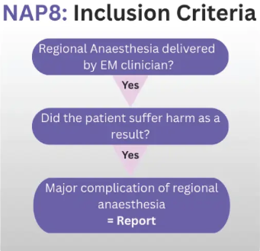
NAP8 Case Registry Inclusion Criteria

Slide 8



Getting Involved
There are several ways to take part:
  Complete the baseline survey
  Support local co-ordination in your department
  Help share and promote NAP 8 locally
  All roles within the ED can contribute
The survey takes 5 minutes
Every response helps ensure your department is represented

Slide 9
Local Co-ordinator Role
Each department has a Local Co-ordinator who:
Shares the survey locally
Encourages participation
Tracks responses
Local teams can support this work

Slide 10
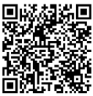
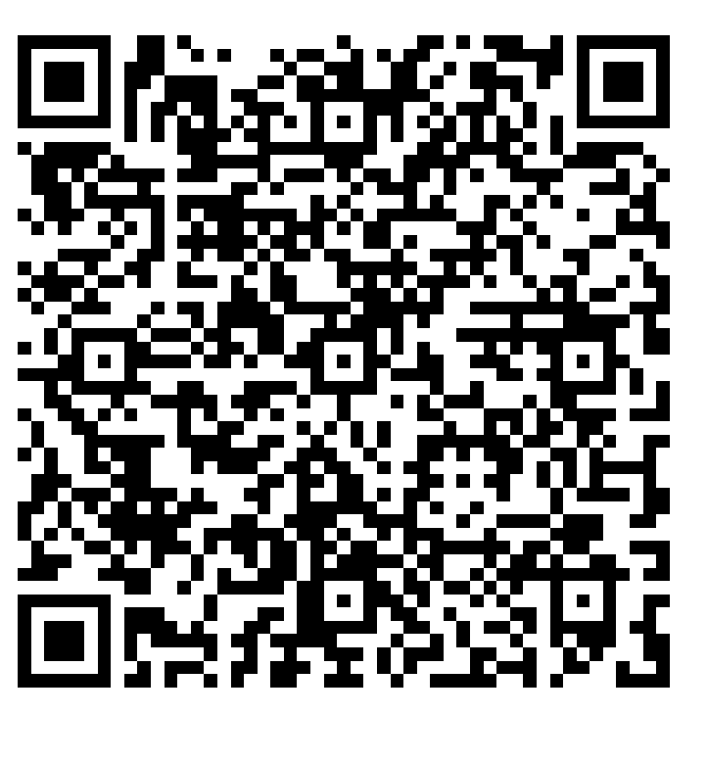
Find out more
Sign Up
Speak to your Local Co-ordinator
Complete the survey
Email - nap8@rcem.ac.uk
www.rcem.ac.uk/nap8
Hospitals with no Local Co-ordinator

